Slide 1
DataSpark
Power BI

Slide 2
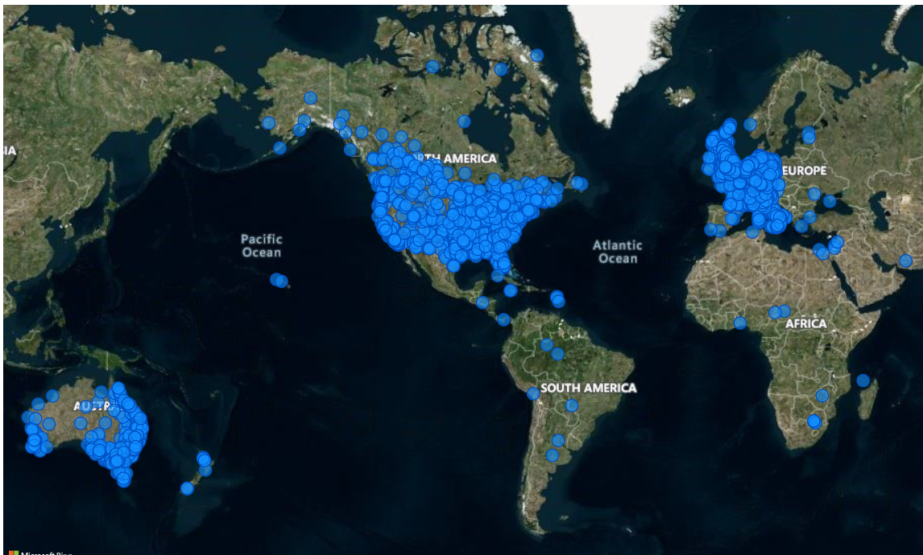
Customers spread across countries
﻿ ﻿﻿Most of sales and customers are spread in North America.﻿﻿ ﻿

Slide 3
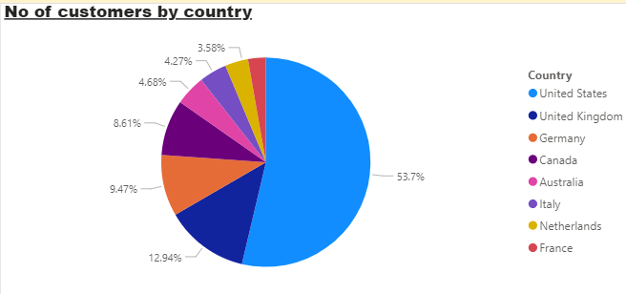
Customers across countries
United States accounted for 53.70% of Count of Customers.
UK accounts around second largest country for business.

Slide 4
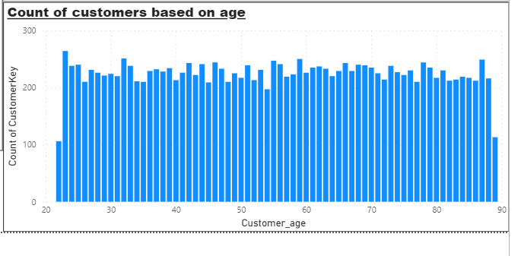
Distribution of customers in different age
﻿At 264 customers count is highest, aged 23
It is 149.06% higher than customers aged 22, which had the lowest Count of Customers of 106.﻿﻿ ﻿﻿ ﻿﻿
23 had the highest Count of Customers of 264, followed by 32 and 59.
﻿﻿Across all age groups Customers aged 68had count ranged from 106 to 264.﻿﻿ ﻿﻿ ﻿

Slide 5
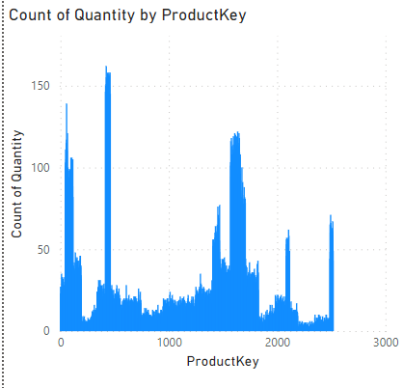
Count of customers for each products key
﻿ ﻿﻿Product key 423 had the highest Count of Quantity at 162, followed by product keys 458 and 446, which tied for second at 158 count of quantity.﻿﻿
﻿423 accounted for 0.26% of Count of Quantity.
﻿Across all 2,492 ProductKey, Count of Quantity ranged from 1 to 162. ﻿﻿ ﻿

Slide 6
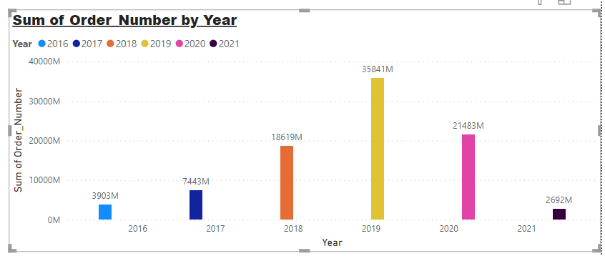
Orders by year
﻿Sum of Orders trended down, resulting in a 31.03% decrease between 2016 and 2021.
Highest orders were in year 2019 and least in 2021.

Slide 7
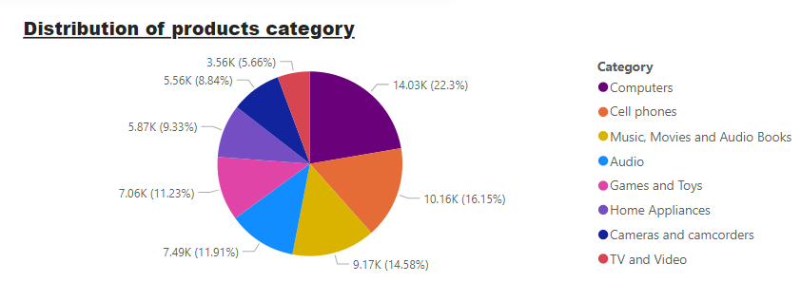
Category distribution
﻿Computers accounted highest for 22.30% of Count of Category.
5.66%, the least category count is for TV and video

Slide 8
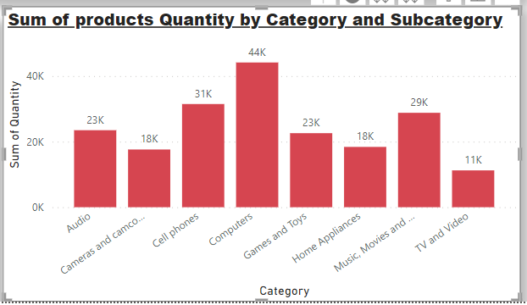
Sum of quantity by category and subcategory
Computers category gives highest quantity for sales of 44K
TV and Videos being lowest
Cell phones are second in quantity sold
Cameras and home appliances gives equal sum of quantity of 18K

Slide 9
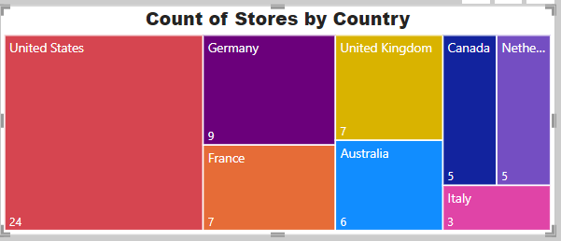
Distribution of stores across countries
Stores are distributed across 8 countries
United States has most number of stores located.
Italy has least number of stores of 3 in count

Slide 10
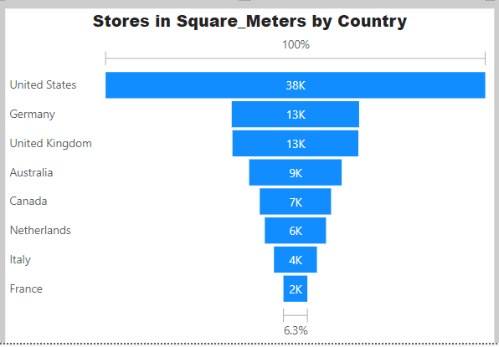
Size of stores in square metres by country
Stores in US are total around 38K sq.m in space.
France accounts 2K sq.m in space

Slide 11
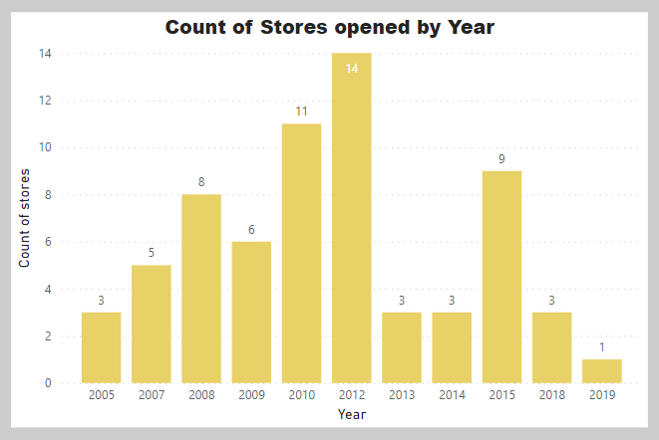
Stores opened by year
﻿Count of Stores opened trended down, resulting in a 66.67% decrease between 2005 and 2019.
﻿Count of Stores started trending down on 2014, falling by 66.67% (2) in 5 years.
Count of Stores opened dropped from 3 to 1 during its steepest decline between 2014 and 2019.
Maximum number of stores were opened in the year 2012.

Slide 12
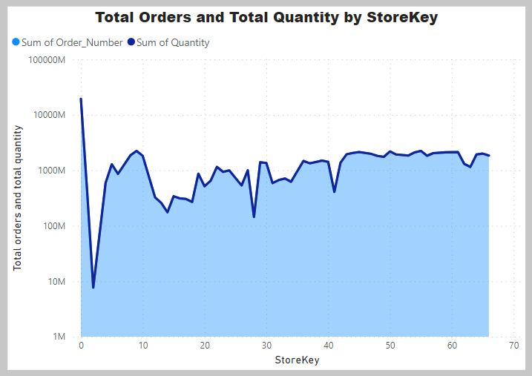
Total orders and quantity by store
﻿At 19394182536, hstore key 0 had the highest orders.
Store key 2 had lowest Orders at 7690104.﻿﻿ ﻿﻿ ﻿﻿
Total Orders and total Quantity are positively correlated with each other.﻿﻿
Store key﻿﻿ ﻿﻿0 accounted for 21.55% of total orders.﻿﻿ ﻿﻿

Slide 13
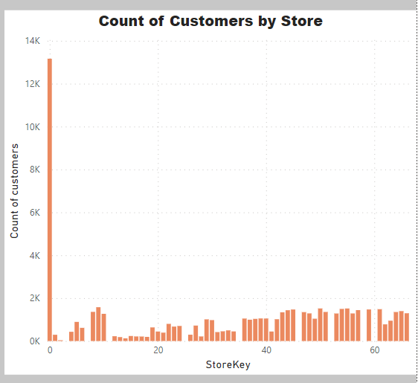
Count of customers by store
At 13,165, store key 0 had the highest Count of Customers
Store key 2 had the lowest Count of Customers at 18.﻿﻿ ﻿﻿
Store key ﻿﻿0 accounted for 20.94% of Count of Customers.﻿
﻿ ﻿﻿Across all 58 Stores, Count of Customers ranged from 18 to 13,165.
﻿﻿ ﻿﻿ ﻿

